Slide 1

Beyond Naive RAG: Adding Agentic Layers
Jerry Liu, LlamaIndex co-founder/CEO

Slide 2

















LlamaIndex
https://llamaindex.ai
https://github.com/run-llama/llama_index
Data Ingestion (llamahub.ai)
Data Indexing
Query Orchestration
(Retrieval, LLMs, Agents)
The framework for connecting your data to LLMs to build a production application.

Slide 3
RAG Stack

Slide 4
Prototyping RAG is Easy
Data Ingestion / Parsing
Data Querying
Chunk
Vector Database
Chunk
Doc
Chunk
Chunk
LLM
Chunk
Chunk
Chunk
5 Lines of Code in LlamaIndex!

Slide 5
But RAG Prototypes are Limited
Naive RAG approaches tend to work well for simple questions over a simple, small set of documents.
“What are the main risk factors for Tesla?” (over Tesla 2021 10K)
“What did the author do during his time at YC?” (Paul Graham essay)

Slide 6
Challenges with “Naive” RAG

Slide 7
Pain Points
There’s certain questions we want to ask where top-k retrieval will fail.
Examples:
Summarization Questions: “Give me a summary of this document”

Slide 8
Pain Points
There’s certain questions we want to ask where top-k retrieval will fail.
Examples:
Summarization Questions: “Give me a summary of this document”
Comparison Questions: “Compare the open-source contributions of candidate A and candidate B”

Slide 9
Pain Points
There’s certain questions we want to ask where top-k retrieval will fail.
Examples:
Summarization Questions: “Give me a summary of this document”
Comparison Questions: “Compare the open-source contributions of candidate A and candidate B”
Structured Analytics + Semantic Search: “Tell me about the risk factors of the highest-performing rideshare company in the US”

Slide 10
Pain Points
There’s certain questions we want to ask where top-k retrieval will fail.
Examples:
Summarization Questions: “Give me a summary of this document”
Comparison Questions: “Compare the open-source contributions of candidate A and candidate B”
Structured Analytics + Semantic Search: “Tell me about the risk factors of the highest-performing rideshare company in the US”
General Multi-part Questions: “Tell me about the pro-X arguments in article A, and tell me about the pro-Y arguments in article B, make a table based on our internal style guide, then generate your own conclusion based on these facts.”

Slide 11
Building a Dynamic QA System
Each question requires a different pipeline implementation
Summarization: Requires retrieving all chunks from document
Comparison: Requires breaking question down into two parallel questions
Structured Analytics: Requires a text-to-SQL setup (instead of RAG)
General Multi-Part Questions: Requires sequential question decomposition, planning, and tool use.
The QA system should dynamically handle different types of questions

Slide 12
Agents 🤖

Slide 13
From RAG to Agents
Query
RAG
Response

Slide 14
From RAG to Agents
Query
Agents?
RAG
Response

Slide 15
From RAG to Agents
Agents?
Query
Agents?
RAG
Agents?
Response

Slide 16
From RAG to Agents
Agents?
Query
Agents?
RAG
Agents?
Response
Agent Definition: Using LLMs for automated reasoning and tool selection
RAG is just one Tool: Agents can decide to use RAG with other tools

Slide 17
From Simple to Advanced Agents
Tool Use
Dynamic Planning + Execution
Routing
One-Shot Query Planning
ReAct
Simple
Lower Cost
Lower Latency
Advanced
Higher Cost
Higher Latency

Slide 18
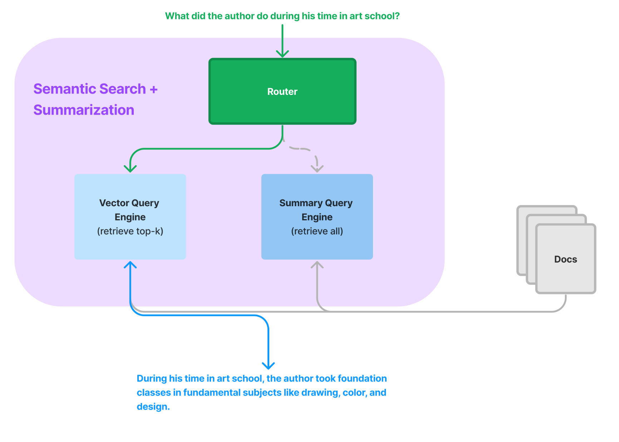
Routing
Simplest form of agentic reasoning.
Given user query and set of choices, output subset of choices to route query to.

Slide 19
Routing
Use Case: Joint QA and Summarization
Guide

Slide 20
Query Planning
Compare revenue growth of Uber and Lyft in 2021
Break down query into parallelizable sub-queries.
Each sub-query can be executed against any set of RAG pipelines
Describe revenue growth of Lyft in 2021
Describe revenue growth of Uber in 2021
top-2
Uber 10-K chunk 4
Uber 10-K
Uber 10-K chunk 8
Lyft 10-K
top-2
Lyft 10-K chunk 4
Lyft 10-K chunk 8

Slide 21
Query Planning
Compare revenue growth of Uber and Lyft in 2021
Example: Compare revenue of Uber and Lyft in 2021
Query Planning Guide
Describe revenue growth of Lyft in 2021
Describe revenue growth of Uber in 2021
top-2
Uber 10-K chunk 4
Uber 10-K
Uber 10-K chunk 8
Lyft 10-K
top-2
Lyft 10-K chunk 4
Lyft 10-K chunk 8

Slide 22
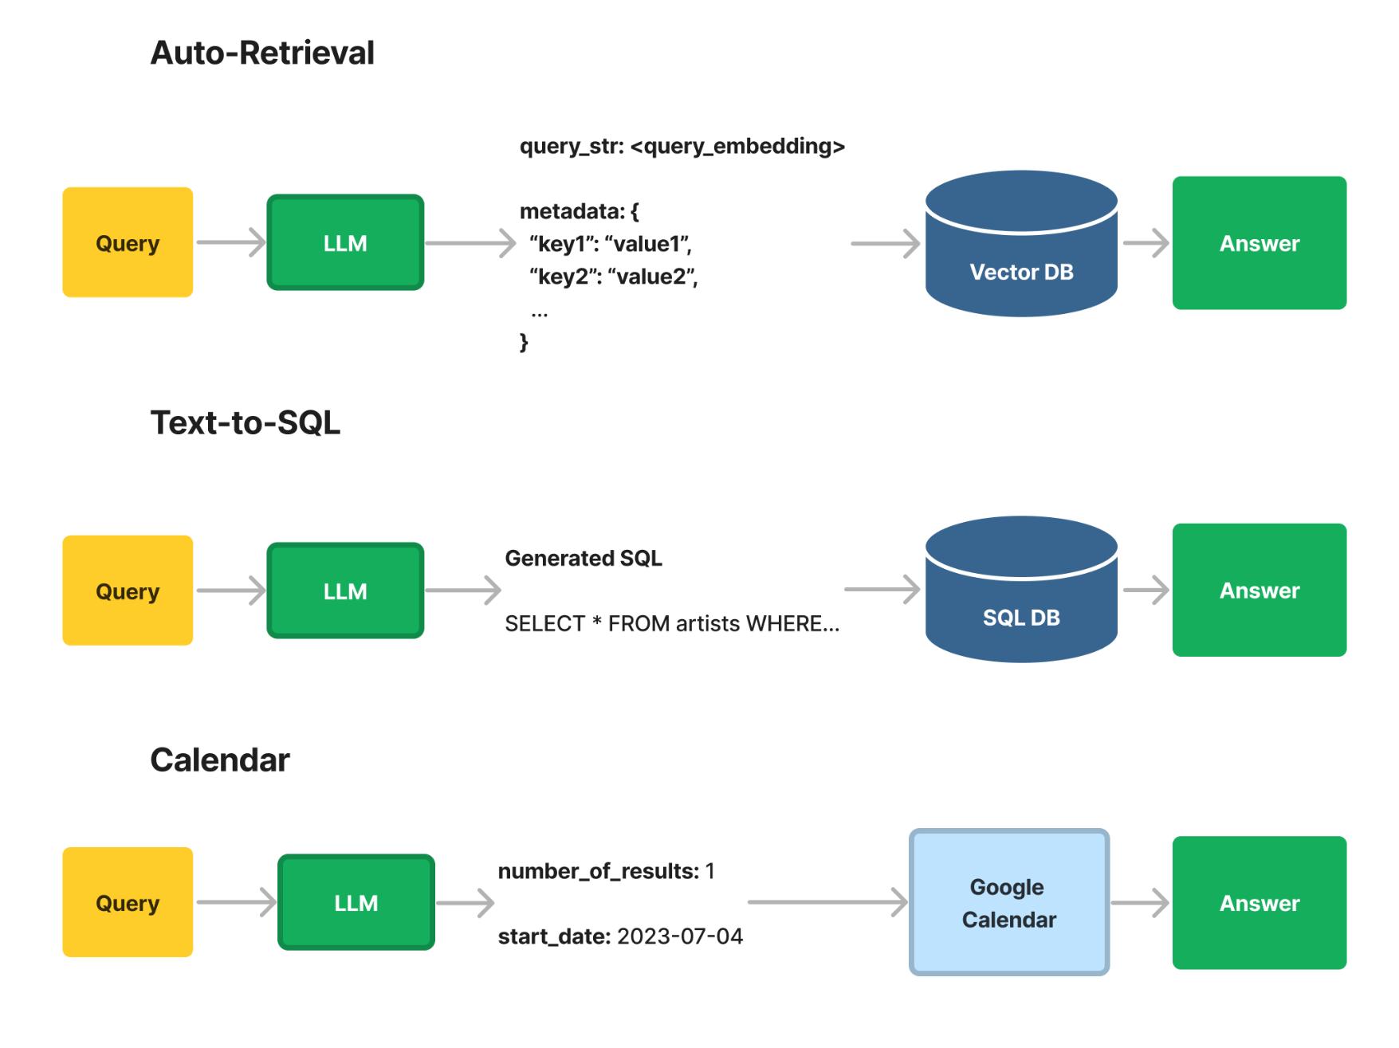
Tool Use
Use an LLM to call an API
Infer the parameters of that API

Slide 23
Tool Use
In normal RAG you just pass through the query.
But what if you used the LLM to infer all the parameters for the API interface?
A key capability in many QA use cases (auto-retrieval, text-to-SQL, and more)

Slide 24
This is cool but
How can an agent tackle sequential multi-part problems?
How can an agent maintain state over time?

Slide 25
This is cool but
How can an agent tackle sequential multi-part problems?
Let’s make it loop
How can an agent maintain state over time?
Let’s add basic memory

Slide 26
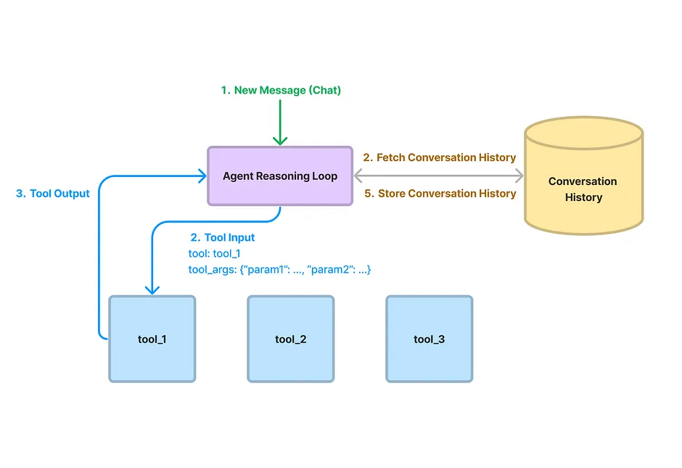
Data Agents - Core Components
Agent Reasoning Loop
ReAct Agent (any LLM)
OpenAI Agent (only OAI)
Tools
Query Engine Tools (RAG pipeline)
LlamaHub Tools (30+ tools to external services)

Slide 27
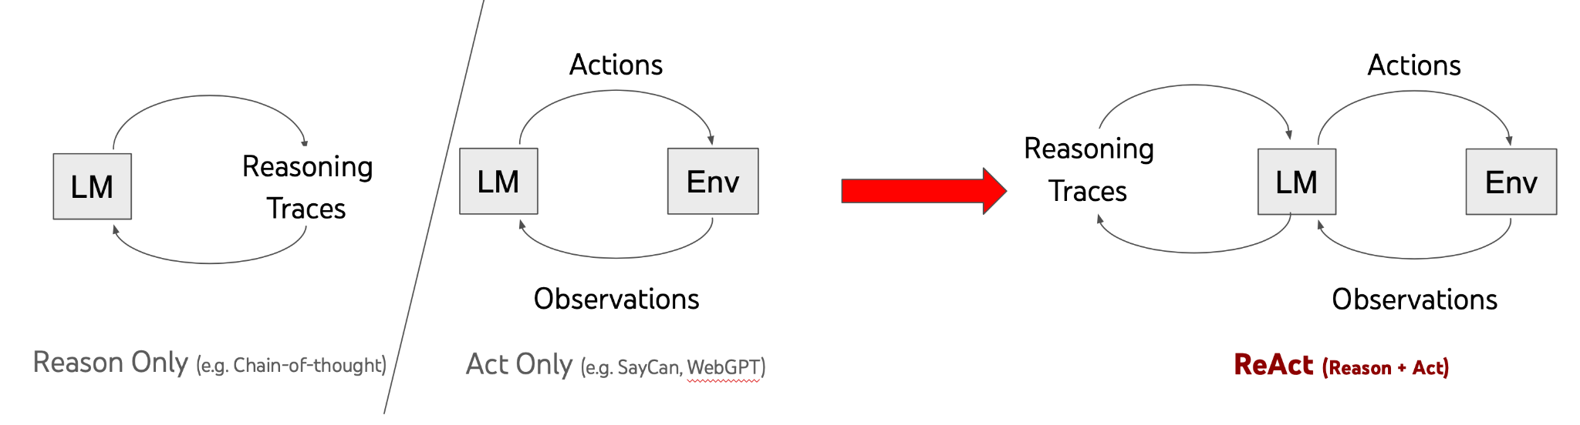
ReAct: Reasoning + Acting with LLMs
Source: https://react-lm.github.io/

Slide 28
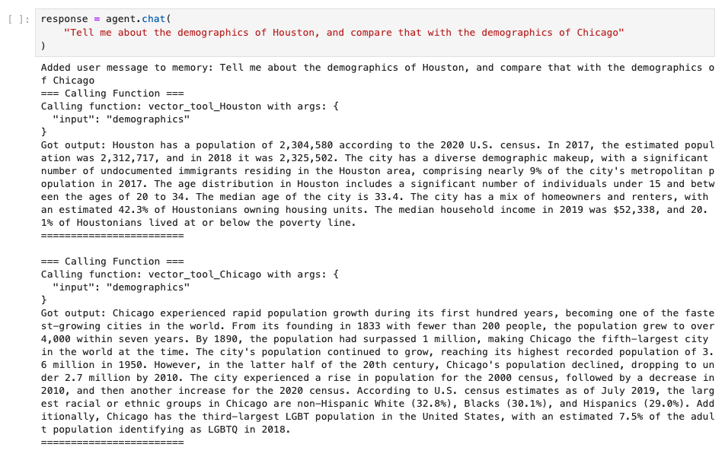
ReAct: Reasoning + Acting with LLMs
Add a loop around query decomposition + tool use

Slide 29
ReAct: Reasoning + Acting with LLMs
Superset of query planning + routing capabilities.
ReAct + RAG Guide

Slide 30
Can we make this even better?
Stop being so short-sighted - plan ahead at each step
Parallelize execution where we can

Slide 31
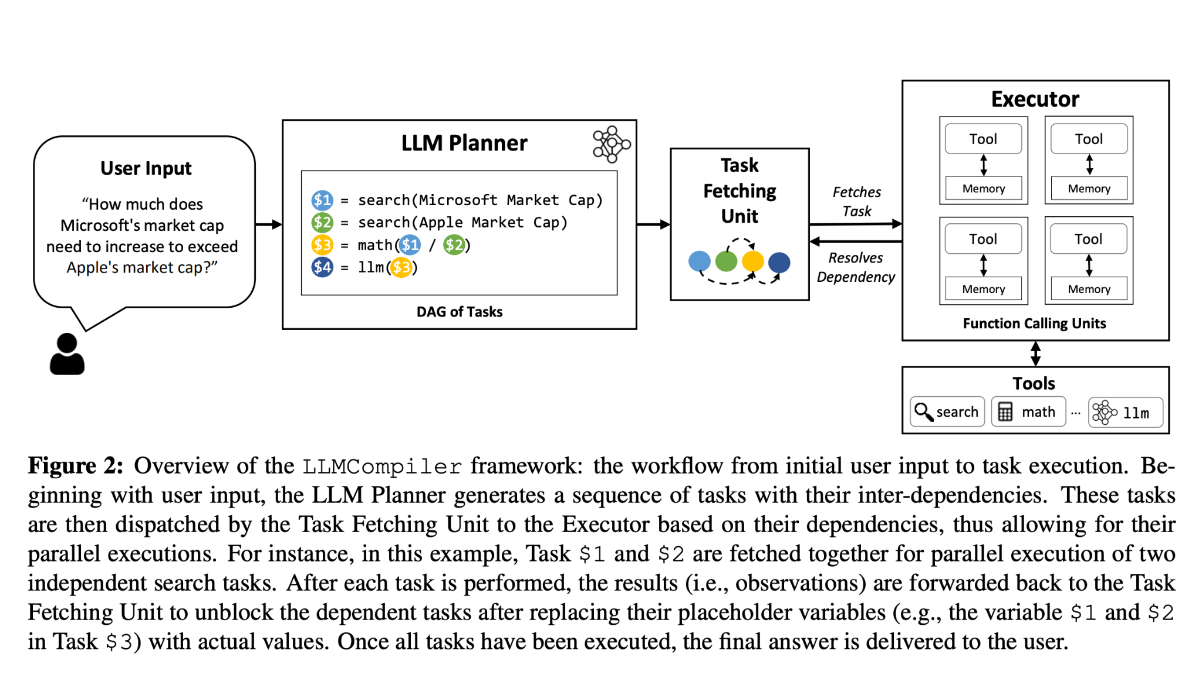
LLMCompiler
Kim et al. 2023
An agent compiler for parallel multi-function planning + execution.

Slide 32
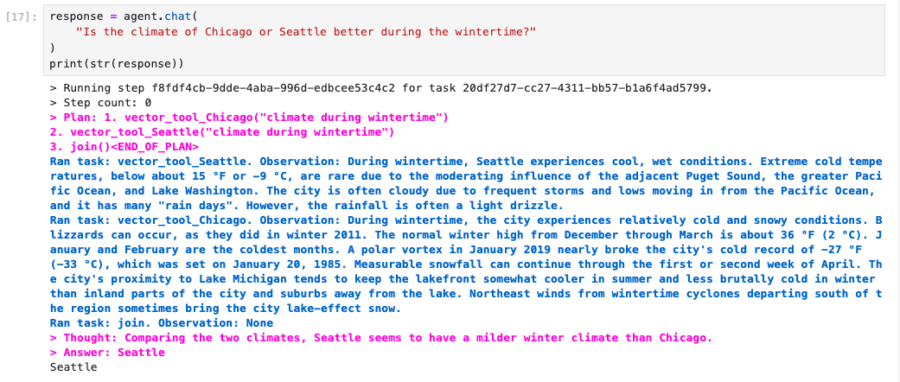
LLMCompiler
Plan out steps beforehand, and replan as necessary
LLMCompiler Agent

Slide 33
Additional Requirements
Observability: see the full trace of the agent
Observability Guide
Control: Be able to guide the intermediate steps of an agent step-by-step
Lower-Level Agent API
Customizability: Define your own agentic logic around any set of tools.
Custom Agent Guide
Custom Agent with Query Pipeline Guide

Slide 34
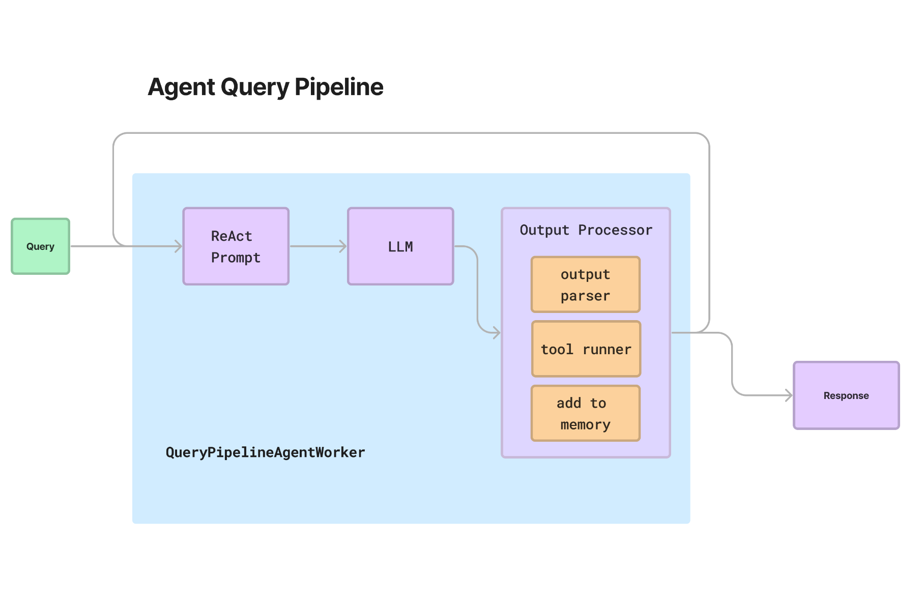
Additional Requirements
Possible through our query pipeline syntax
Query Pipeline Guide

Slide 35
Thanks!
Routers
Query Planning
ReAct Agent
LLMCompiler Agent
Custom Agents with Query Pipelines

